Slide 1
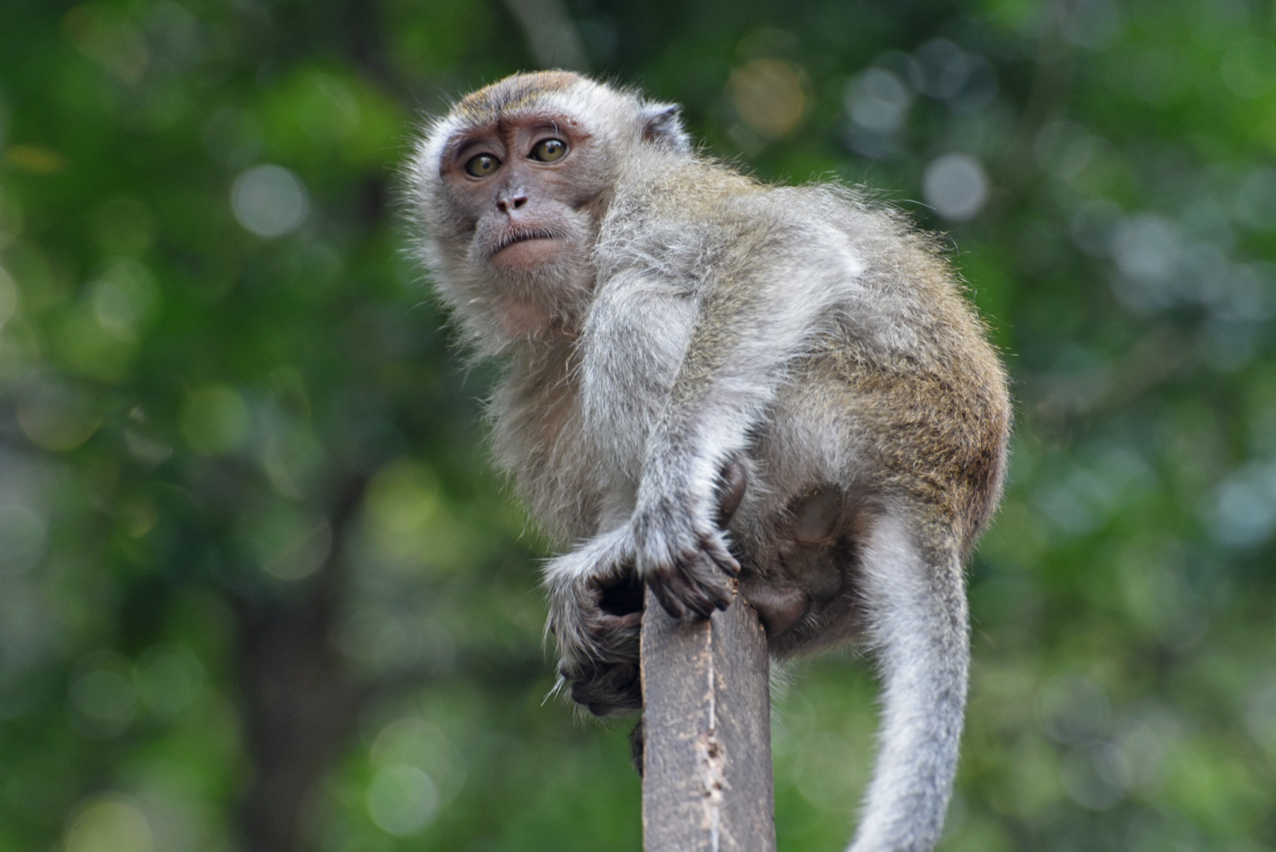
MOOC Quality Malaysia
Stephen Downes
May 2, 2016

Slide 2
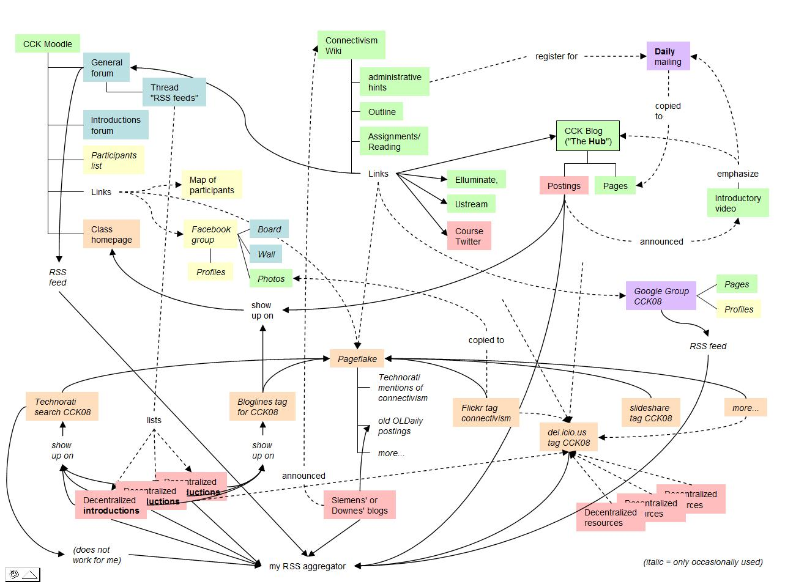
Connectivist MOOCs
http://x28newblog.blog.uni-heidelberg.de/2008/09/06/cck08-first-impressions/

Slide 3
What are MOOCs
Massive – by design
Open – gratis and libre
Online – vs. blended and wrapped
Courses – vs. communities, websites, video collections, etc
http://mooc.ca

Slide 4
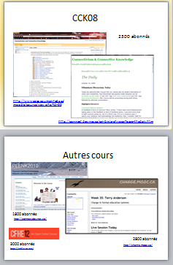
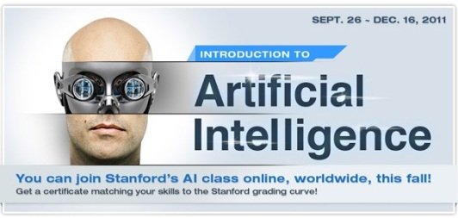
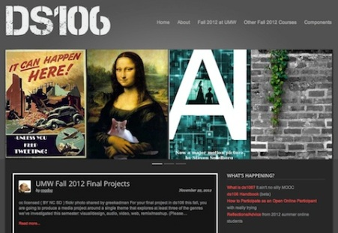
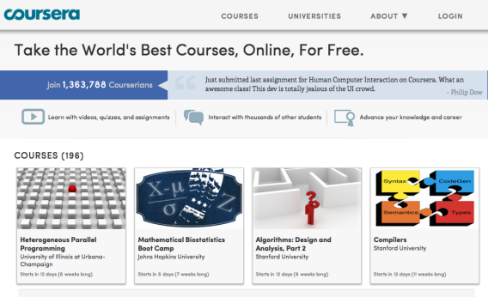
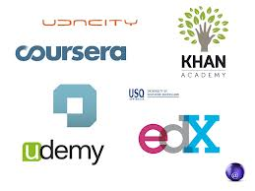
cMOOC vs xMOOC
networks
tasks
contents
https://www.ai-class.com/
http://ds106.us/history/
https://www.coursera.org/
http://lisahistory.net/wordpress/2012/08/three-kinds-of-moocs/

Slide 5
Two Approaches…
Content
Practice
Practice
Content

Slide 6
Two Approaches…
Defines an ideal state
Defines a desired state
Content
Practice
Practice
Content
TEST
TRY
Person tests you
Person helps you

Slide 7
Two Approaches…
Defines an ideal state
Defines a desired state
Content
Practice
Correction
Iteration
GAP
Practice
Content
Opport-unity
TEST
TRY
Person tests you
Person helps you

Slide 8
Library Environment
Defines an ideal state
Defines a desired state
Content
Practice
Affordances
Correction
Requirements
Iteration
GAP
Practice
Content
Opport-unity
TEST
TRY
Person tests you
Person helps you

Slide 9
Personalized Personal We do for you You do for yourself
Defines an ideal state
Defines a desired state
Content
Practice
Affordances
Correction
Requirements
Iteration
GAP
Practice
Content
Opport-unity
TEST
TRY
Person tests you
Person helps you

Slide 10
Personal vs. Personalized
Compare between:
Personalized health care (something the National Health Service or Health Management Organization provides)
Personal health care (something you do for yourself)
Personal goals versus institutional goals
Practice versus content

Slide 11
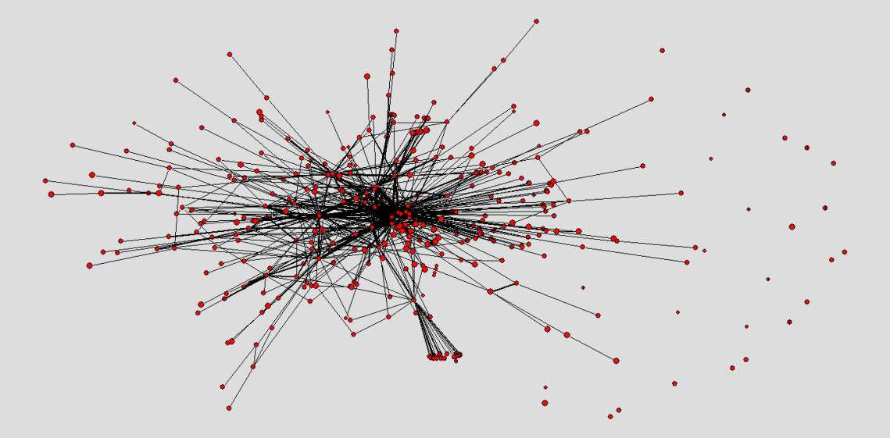
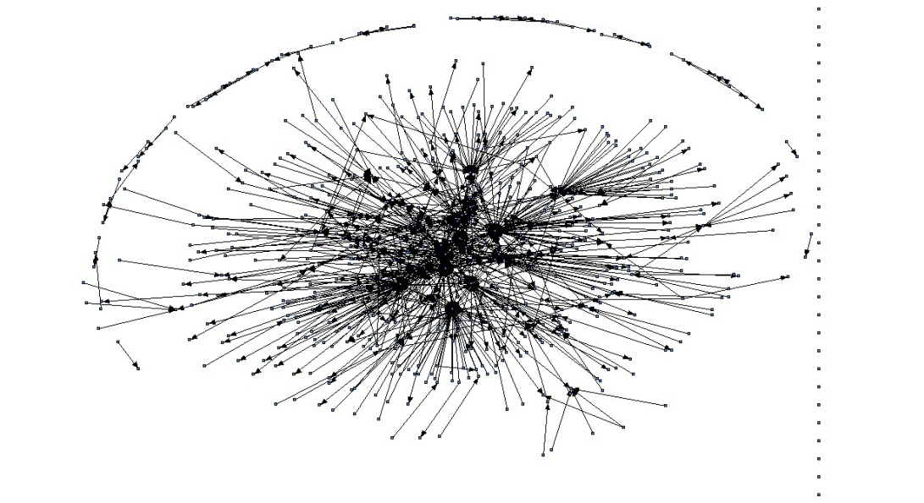
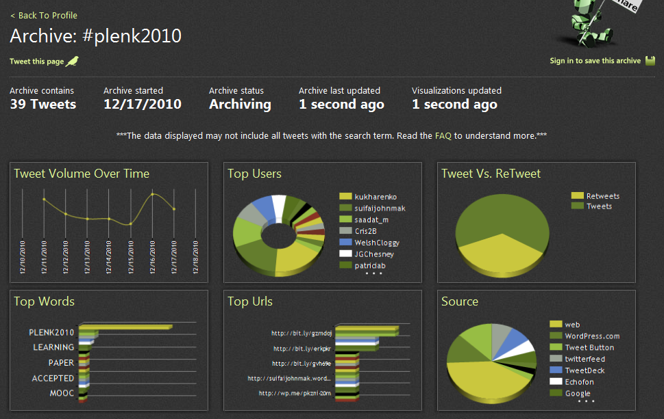
The Semantic Condition
Autonomy, diversity, openness, interactivity
These conditions are the conditions for a constructive dialogue…
And are thus the design principles for a MOOC
http://itforum.coe.uga.edu/paper92/paper92.html

Slide 12
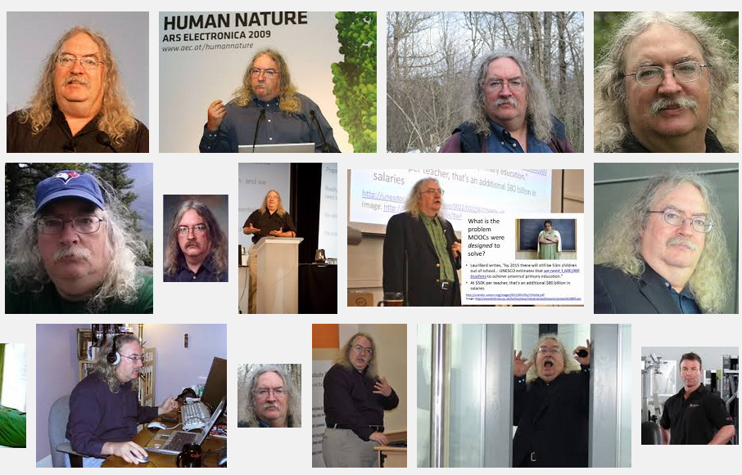
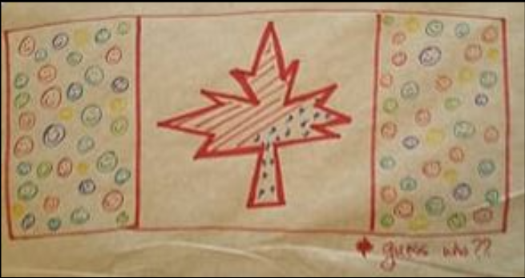
Stephen Downes
http://www.downes.ca

